Slide 1

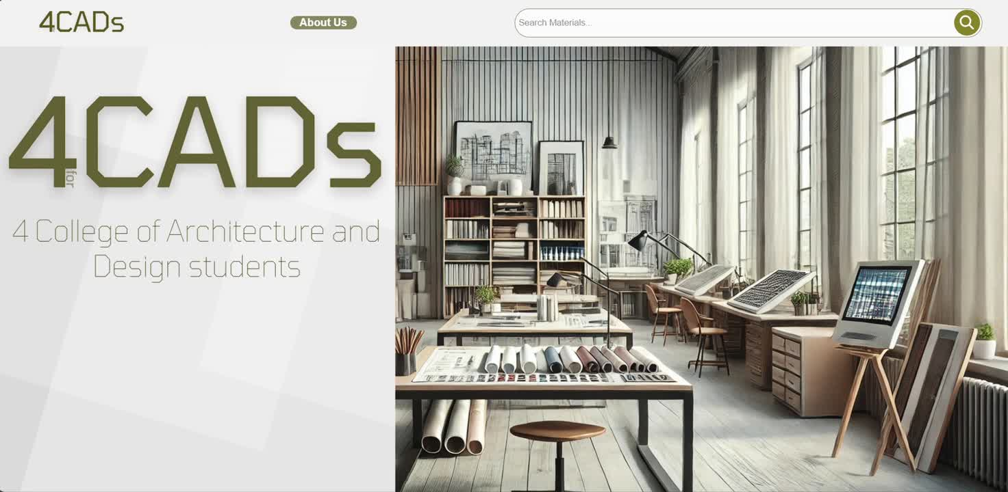
CLASS
PRESENTERS
CS104
Ray Sama, Juan D. Ahumada, Ganpath Ramesh, Damaris Espinoza,
4CADs
Launch
for
Developers:
Ray Sama (003)
Juan D. Ahumada (001)
Ganpath Ramesh (003)
Damaris Espinoza (003)
4CADS
Stakeholder: Kaustubh Vijaykumar Pethkar

Slide 2

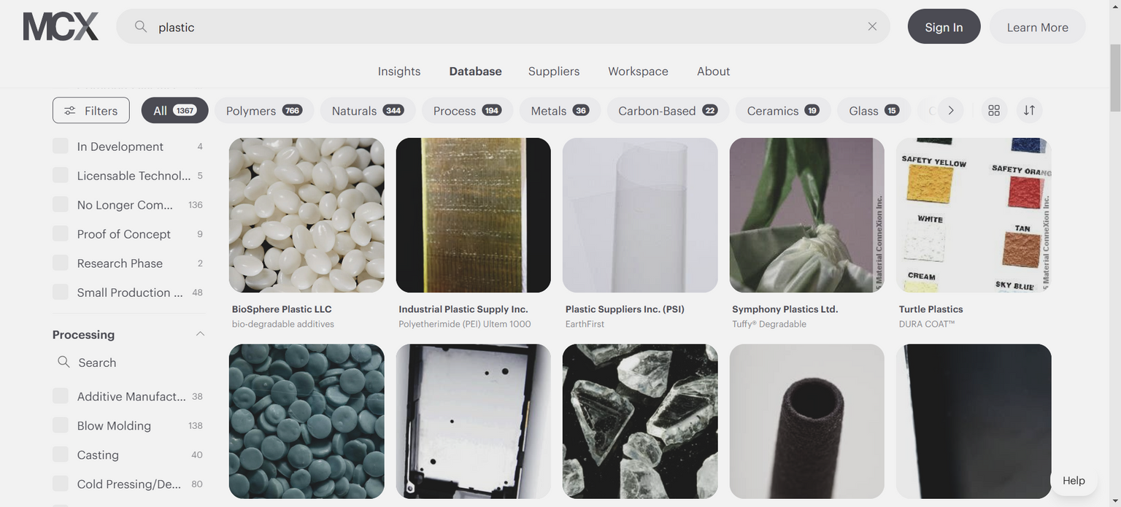
INTRODUCTION
Project Summary
4CADs
for
4CADs
for
Problem Statement
Design students have a rare number of educational platforms dedicated to learning material properties, although having access to this type of information can help students make informed choices for their projects, stepping into an applicable understanding of materials. Most online material catalogues today don’t specifically target students’ learning needs. They serve as a database that neither guides nor introduces students to foundational material details that would be advantageous in conceptualizing designs or structures . Primarily serving inexperienced individuals in material research comes 4CADs

Slide 3
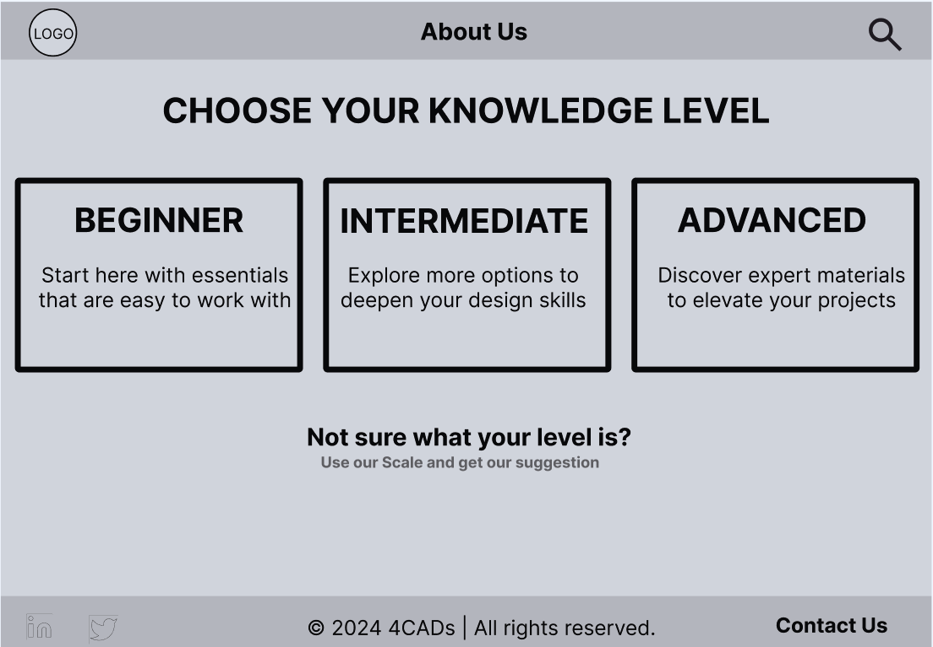
INTRODUCTION
Project Summary
4CADs
for
4CADs
for
What is 4CADs ?
4CADs is a website designed by 4 College of Architecture and Design students, in similar sounding, it is designed “for College of Architecture and Design students” like we are at the New Jersey Institute of Technology. Even more, it is for individuals interested or practicing in design related fields like Architecture or Industrial Design for instance. It addresses a challenge of many early-stage designers i.e. finding reliable, educational sources for learning about materials that can meet the needs of academic or personal projects and maybe even early professional work.

Slide 4
Builiding Process
02
01
Requirements
Non-Fuctional
Functional
The interface should be intuitive and easy to navigate(the simpler the better)
Make it engaging and interactive(Having a logo, a homepage with a video, and even an about us page are things that set the score for making this website inetresting
The website should be scalable, allowing for future growth as more materials are added.
Search bar
Level of Expertise Page
Material images
Material Catalog
Educational Content
Real-world uses & why
Material Properties
Sustianability
Manufacturers
4CADs
for
Conlusion
To build this, we concluded that the website would need to have certain functionalities to make it appealing and exceptionally useful to students like us without much prior knowledge of materials. Conclusions like “If it were going to be a website it should have a search bar for materials” and “It should have materials categorised by level of expertise, not everyone might be an expert, but people may feel they are more familiar with certain materials, thus there are categories on our website ” “The goal is to have a website that can educate early minds like us students”. ”The website must include images of materials, and write about their applications, properties and the emerging concern of sustainability, without forgetting Manufacturers of various materials

Slide 5




Work input
4CADs
for
Methods
To accomplish our requirements, we strategically planned our methods and approach. We scheduled times individually and collectively to both develop the website and talk about our development such as things done so far, things in progress, and things still to begin. Overall our progress has been both individual work, collaborative meetings, and a messaging correspondence towards the development of 4CADs
NEXT

Slide 6

Tasks completed
4CADs
Materials content research(Applications, Properties, Suatainability)
Manufacturers research
Materials Content Page (Bootstrap)
for
Inputting Researched Materials into respective pages
Methods
There is a need for accurate and useful material information on our website, which is both engaging and informative to students like myself. My name is ... I am an Architecture student student at the New Jersey Institute of Technology, I am also the Material Content Researcher for 4CADs . In developing this website, I am responsible for building the Materials content page from its foundational Bootstrap version and continued developing it with the assistance of my teammates to what it has become now.
NEXT

Slide 7
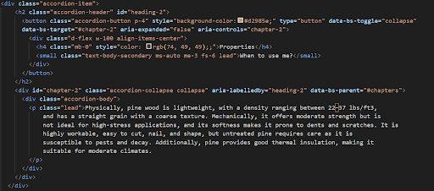
Challenges Faced
Materials content research(Applications, Properties, Suatainability)
Manufacturers research
Materials Content Page (Bootstrap)
Inputting Researched Materials into respective pages
4CADs
for
Code Challenges
Despite fulfilling my tasks, there were a number of challenges I faced in my code’s development for the website, for instance, I had... when I tried to do that, ... I also had another challenge in trying to get the... to be ... The image on the left is the result of finding a solution to one of my challenges faces, where I had the problem of, what I did was... to fix the problem and it worked
NEXT

Slide 8
4CADs
for
DEVELOPER: DAMARIS ESPINOZA
Thank You

Slide 9
Tasks completed
4CADs
Foundational HTML structure for choose your level page
First Low-Fidelity Website Mockup
Website footer structure code
for
Foundational HTML structure for About Us page
Methods
The 4CAD level selection page is something I am responsible for building from scratch. My name is Juan Ahumada. I am an Architecture student at the New Jersey Institute of Technology and I am also the Web Structure Developer for 4CADs. I created the HTML and CSS styling of the level selection page based on the initial mockup, which was further developed into its current look. In addition, I am also responsible for creating the base model of the "About Us" page, which was completed with the addition of information and some adjustments by my teammates.
NEXT

Slide 10
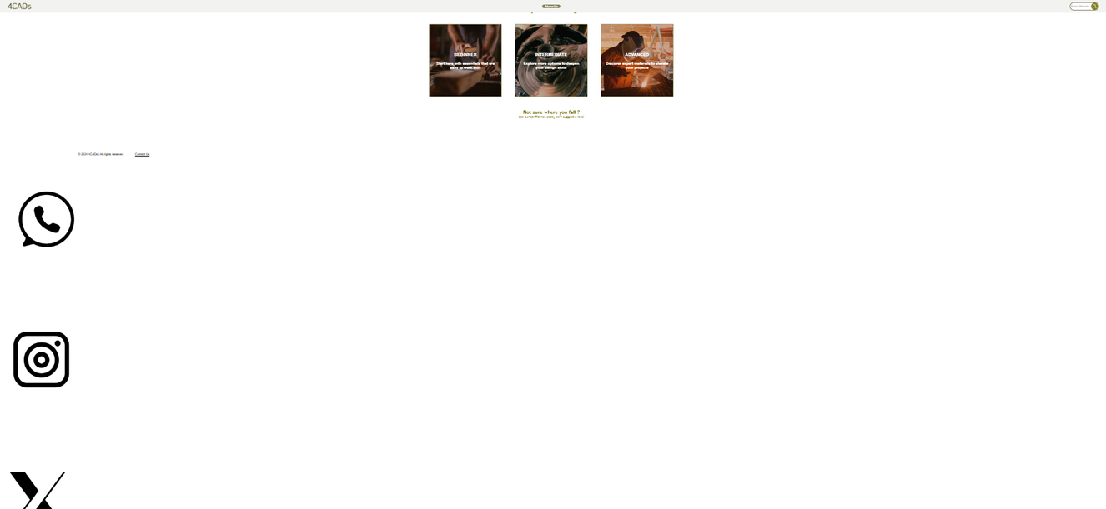
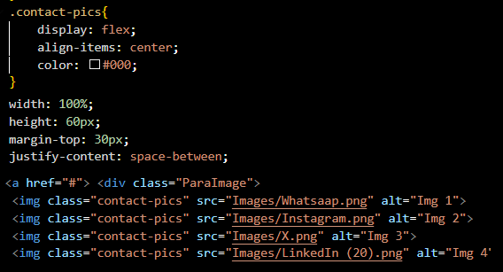
Challenges Faced
DIV not staying aligned or centered on the page
Elements are not in correct place
Alignment of the images in the footer.
NEXT
Code Challenges

Slide 11
4CADs
for
DEVELOPER: JUAN A. AHUMADA
Thank You

Slide 12
Tasks completed
4CADs
HTML for Material categories(Beginner, Intermediate, Advanced)
CSS styling for category pages(Beginner, Intermediate, Advanced)
Text descriptions and CSS animation for each category’s material card
for
Website error inquisitions from class Instructor/TA
Methods
Our website has three different experience categories for its visitors, I am responsible for the development of those pages. My name is ... I am an Industrial Design student at the New Jersey Institute of Technology, and I am also the User Experience Reviewer for 4CADs . I built the Beginner, Intermediate and Advanced Pages of 4CADs. Additionally, when designing these pages, I used various CSS styling and animations like when a user hovers over a material card, it scales up and provides them brief information on the hovered material. I also edited in this text information. With the team facing website struggles like getting the previous page button to function properly, I a responsible for making inquisitions from our class Teaching Assistant on how we can solve the problems which were later fixed.
NEXT

Slide 13
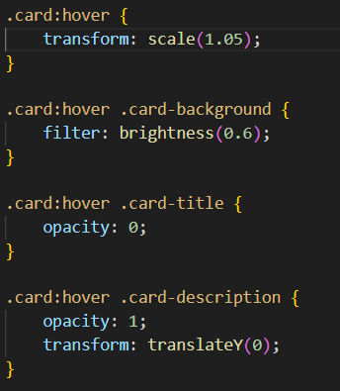
Challenges Faced
Transform
Opacity
Class
Displaying information
4CADs
for
Code Challenges
While creating ideas to make the website more convinent to use, I decided to make a preview description appear before choosing the material. Initial this idea seemed easy to execute until, we ran into obstacles making it functional. We were able to resolve this with the help of the Teacher assistant though modifying the code.
NEXT

Slide 14
4CADs
for
DEVELOPER: GANPATH RAMESH
Thank You

Slide 15
Tasks completed
4CADs
Websites’s homepage design (4CADs logo, landing page video)
Interactive website Navigation bar with, About Us page and Search bar
High Fidelity mockup design for all web pages
for
About Us page development, with image, description, and other info
Methods
Our website’s homepage is supposed to be inviting and also easy to understand as one of our website requirements suggests. My name is Ray Sama, I am an Industrial Design student at the New Jersey Institute of Technology, and the Project Lead of 4CADs. Following the very first low-fidelity mockup a team member(Juan) came up with, I started designing mockups more refined to the purpose of the website. I did the homescreen with a video showing our logo and displayed different materials showcasing what the website does. I designed the navigation bar, linking the about us page to it, as well as the interactive search bar the website has.
NEXT

Slide 16
Challenges Faced
4CADs
Having the navigation bar function of every page of the website (boostrap)
Team communication concering tasks, in a timely manner
for
Getting the video contained within the screen’s frame
Inputting Researched Materials into respective pages
Code Challenges
I attempted to make the video fit within the entire screen of the viewer, using width in the styling in pixels, This was many times inconvenient because I was usually either too much inside the screen’s width or too far outside, extending the entire display, my solution to this was using the video’s width as 100% instead of having pixel values like 100px
NEXT

Slide 17
4CADs
for
DEVELOPER: RAY SAMA
Thank You

Slide 18
CLASS
PRESENTERS
CS104
Ray Sama, Juan D. Ahumada, Ganpath Ramesh, Damaris Espinoza,
Thank You
4CADs
For viewing the
Launch
for

